Slide 1
GA 3331 – Game Prototyping
Week 1
Keith Miron
Senior Gameplay Engineer – Blizzard Entertainment (Unnaounced Game)

Slide 2
Examples of prototypes
Team Colin’s Beard
Team Faaaaabulous

Slide 3
GA 3331 – Game Prototyping
What does Prototyping mean to you?

Slide 4


Personal background
Long time gamer
Games I play
Why I decided to get into the game industry…
Programmer
Work History
inXile Entertainment
Blizzard Entertainment
What is my day like?
Notes:
How did I start?
What am I doing now?
Personal background from students

Slide 5

Question: How do you make a game like World of Warcraft?
Hint: Slooowwlyy…
Notes:
Prototype?
Funny wow stories
Kaplan’s story (Marcus Jonathan)
In Mists of Pandaria, General Marcus Jonathan was killed at the Battle for Theramore, he was replaced by General Hammond Clay <High Commander of Stormwind Defense>.

Slide 6
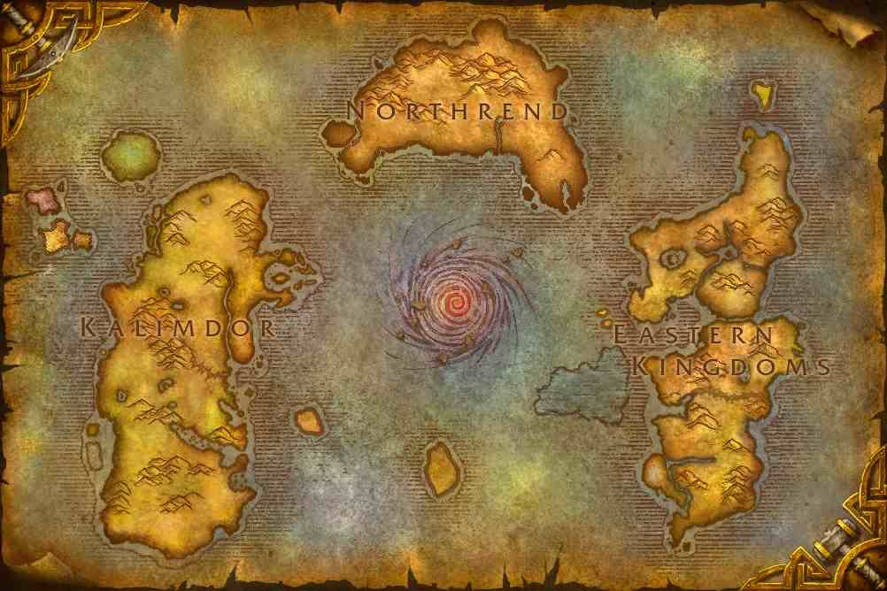
Well, what is WoW, exactly?
Quests
PvP
Raids
Story
Music
Art
Groups
Races
Classes
Skills
Mining Skinning
Herb gathering
Pwning Noobs
Etc…
Notes:
What features are common in other MMOs?

Slide 7
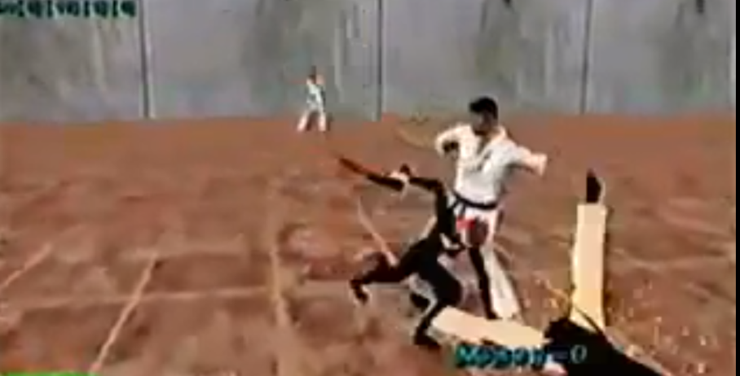
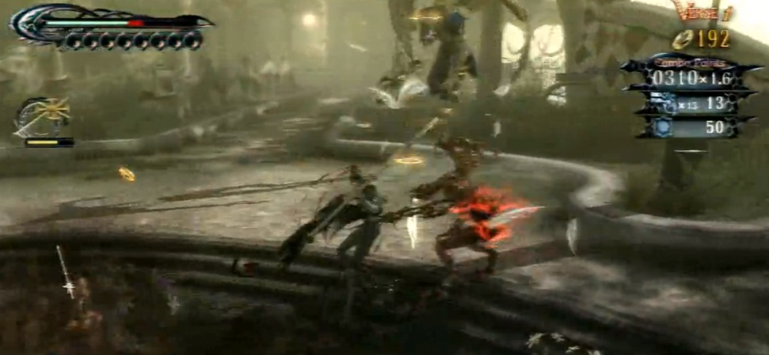
Prototyping
Why is it important?
IE: Why are they making me take this class?

Slide 8
Course Outline
Analog Games
Unity
GAD/VGP
What good is this to me in the games industry?
Lectures/Contact Info
Notes:
Syllabus

Slide 9
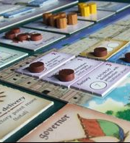
Analog Games
For Example:
Board games
TCG
D&D
“Eurogames”
Notes:
We will be doing analog games for the first two weeks, then every 2 weeks after will be digital prototypes

Slide 10

Unity
Why are we using this?
Games using Unity:
Hearthstone
Scrolls
Wasteland 2
Guns of Icarus Online
Temple Run 2
Notes:
Also Playmaker

Slide 11

Playmaker (LINK)
Visual Scripting Plug-in for Unity
Flexible, lots of features
Notes:
Realize your creative vision without knowing how to program!
Visual state machines are intuitive and powerful for beginners and pros!
Programmers love visual state machines too.
Works with Indie and Pro versions of Unity.
Intuitive Visual Editor
Quickly add States and Actions.
Connect States with Transitions.
Manage Events and Variables.
Save time with Templates and Copy/Paste.
Integrated Help.
Powerful Debugging
Realtime Error Checker finds errors before you hit play!
Runtime Debugging lets you watch state machine behavior.
Set Breakpoints and Step through state changes.
Watch Variables as the game plays.
Send Events and Set Variables at any time.
Use the Log Window to watch transition events.
Highly Extendible
Write Custom Actions and they appear in the editor.
Custom Actions available for many popular addons:
Photon, 2D Toolkit, iTween, NGUI, Smooth Moves...
User Community shares actions on the Forums and Wiki.
Open API allows you to make FSMs in code.

Slide 12

GAD and VGP
Use your strengths.
Discover your career goal.
Notes:
Career goal

Slide 13
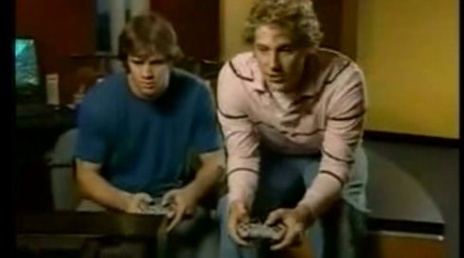
The Games Industry and you.
More than just tightening up graphics on level 3!

Slide 14
Questions?
Notes:
Time to play a game of war

Slide 15
Game of War : Rules
The deck is divided evenly among the two players, giving each a down stack.
In unison, each player reveals the top card of their deck - this is a "battle" - and the player with the higher card takes both the cards played and moves them to the bottom of their stack.
If the two cards played are of equal value, then there is a "war".
Both players play the next one or thre^{e} cards of their pile face down, depending on the variant, and then another card face-up.
The owner of the highest face-up card wins the war and adds all six or ten cards on the table to the bottom of their deck.
If the face-up cards are equal, then each player adds two new cards as before until one player's face-up card is higher than their opponent's.

Slide 16
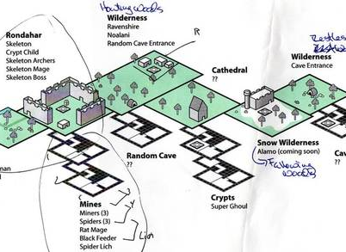
Design Documents
Every great game starts somewhere..

Slide 17
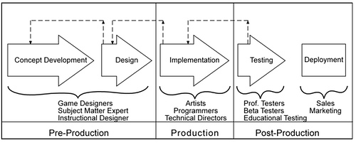
Game Development Life Cycle
Pre Production
High Concept
Pitch
Concept
GDD

Slide 18
Game Development Life Cycle
Production
Design
Programming
Level Creation
Audio
Testing
Milestones (Alpha, Beta, GM)

Slide 19
Game Development Life Cycle
Post Production
Patches/Maintenance

Slide 20
Time to Prototype!

